Slide 1
Midterm Review
Sihan Wei
Intro to Machine Learning

Slide 2
About the Exam
Time: Thursday, July 17, 1:15-3:00 PM
Location: SHL 105
Closed book
No cheat sheet
All material covered before the midterm, up to (and including) decision trees

Slide 3
Question Types
T/F questions
Short answer questions (Long questions, with multiple parts)
Use the practice questions on our course website to get a sense of the format.
We won’t test derivations or proofs.
  Focus on understanding the concepts we have covered so far.

Slide 4
Today
Quick Run-Through of Course Material
The slides shown today are just a selection. You’re still responsible for reviewing all course content when preparing for the exam.
I won’t go into the details. The goal is to refresh your memory and answer any questions you may have.

Slide 5
Intro+Foundations
Instance space? Label Space? Learning algorithm? Loss functions?
Hypothesis class and tradeoffs
Generalization/Overfitting vs. underfitting
The i.i.d. assumption
Empirical risk minimization
Bias/variance tradeoff

Slide 6
Practice questions
If our model is overfitted, then will it have high bias or high variance?
  High variance
If our model is underfitted, then will it have high bias or high variance?
  High bias

Slide 7
Explanation
An underfitted model is too simple to capture the underlying structure of the data — it performs poorly on both training and test sets. This is a sign of high bias, where the model makes strong simplifying assumptions and misses the complexity.
An overfitted model fits the training data too closely, capturing noise and fluctuations that don’t generalize to unseen data. It performs very well on training data but poorly on test data — this is a sign of high variance.

Slide 8
Bias-variance tradeoff
Model too simple -> underfitting -> high bias, low variance
Model too complex -> overfitting -> low bias, high variance

Slide 9
Regularization
We use regularization to prevent our model from being too complex (i.e., overfitting).
Thus, regularization will increase the bias of our model, but reduce the variance.
This helps improve generalization

Slide 10
Regularization
L1 Regularization
  Tends to produce sparse solutions
  Can perform feature selection
L2 Regularization
  Tends to produce small weights (but not sparse)
  Keeps all features (no selection)

Slide 11
Linear regression
Least squares objective
Closed-form OLS solution
Gradient descent (vs. closed-form)
Ridge vs. Lasso (what and why)

Slide 12
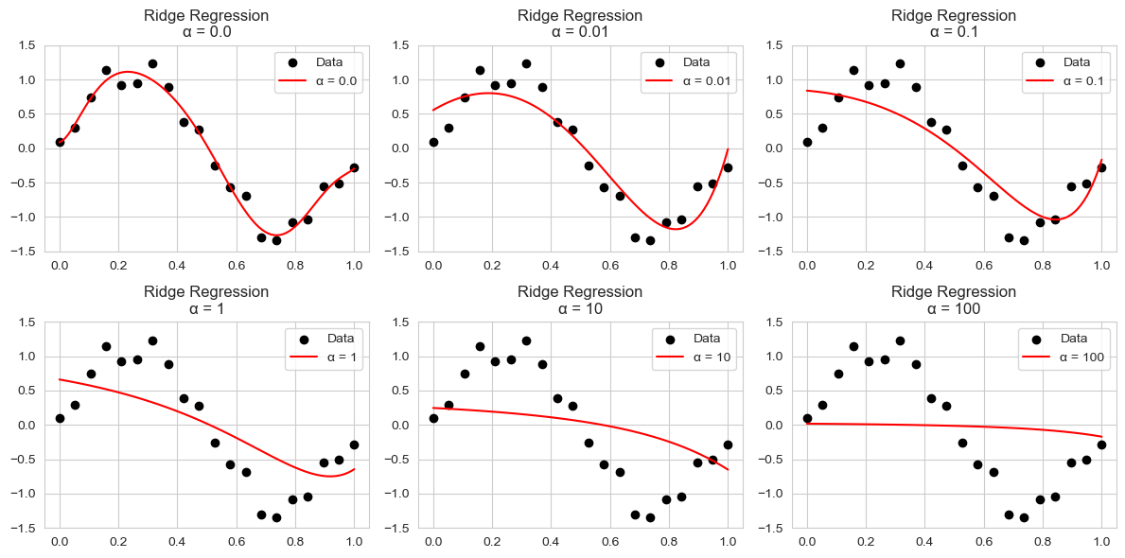
Questions?
How does our model behave when we increase the regularization parameter in Ridge regression?
Higher α → smoother curve, less variance, more bias

Slide 13
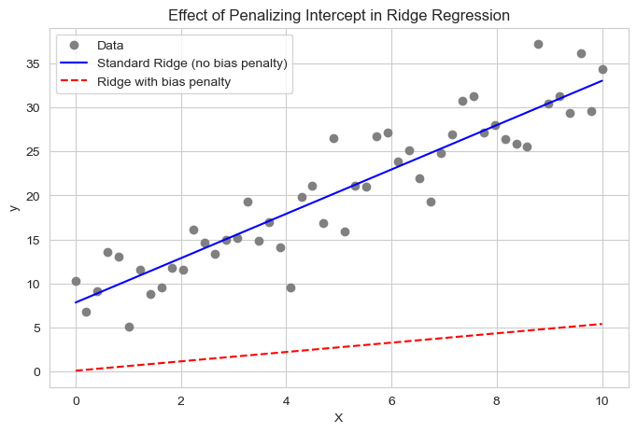
Questions
What if we are fitting a straight line and increase α?
  Shrink the weight w toward zero and make the slope of the line flatter (close to horizontal)
Do we penalize the offset in Ridge regression?
  No. Because
  The intercept controls vertical shift — not complexity
  Penalizing it would push the line unnecessarily toward passing through the origin (bad if the data's mean is not centered)

Slide 14
Optimization
Convexity: local minimum = global minimum
Convex surrogate loss functions
  Hinge loss
  Exponential loss
  Logistic loss
Gradient based optimization methods:
  (Batch) Gradient descent
  SGD

Slide 15
Logistic Regression
Logistic (sigmoid) function
Probabilistic interpretation
  Log-odds ratio
Maximum Likelihood estimation
Loss function
No closed-form solution. GD (SGD) to help!
Multiclass cases: softmax + cross-entropy

Slide 16
SVM
Max-margin classifier
  What is a margin?
Hard-margin SVM
  Optimization objective
  Primal and dual formulations
  Constraints
Soft-margin SVM
  Slack variables
  How does the parameter C control the margin

Slide 17
SVM
What are support vectors?
  Given a plot, you should be able to identify all SVs.
What’s the relationship between a support vector and its associated Lagrange multiplier alpha?
What if our data is not linearly separable?
Number of parameters in the primal vs. dual form
  Given a real-world scenario, decide whether to use the primal or dual formulation.

Slide 18
Kernels
What is a feature map?
What is a kernel function?
  Given a kernel, can you find the corresponding feature map?
Common types of kernels
  Polynomial, RBF (Gaussian), linear, etc
For RBF kernels, how does sigma/gamma affect our model?
  What happens when gamma is large vs. small?

Slide 19
Decision Trees
Stopping criteria in ID3
What is entropy
What is conditional entropy
How to select features using information gain
  Given a simple toy dataset, you should be able to compute the information gain for each attribute.
All the formulas will be given.

Slide 20
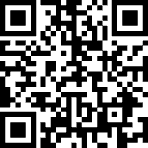
Knowledge check

Slide 21
Questions?

